Slide 1
Networking Concepts NET191 DeVry University Michael Radel

Slide 2

Module 2 Michael Radel IPv4 Addressing (using a Virtual Machine environment and Linux)

Slide 3
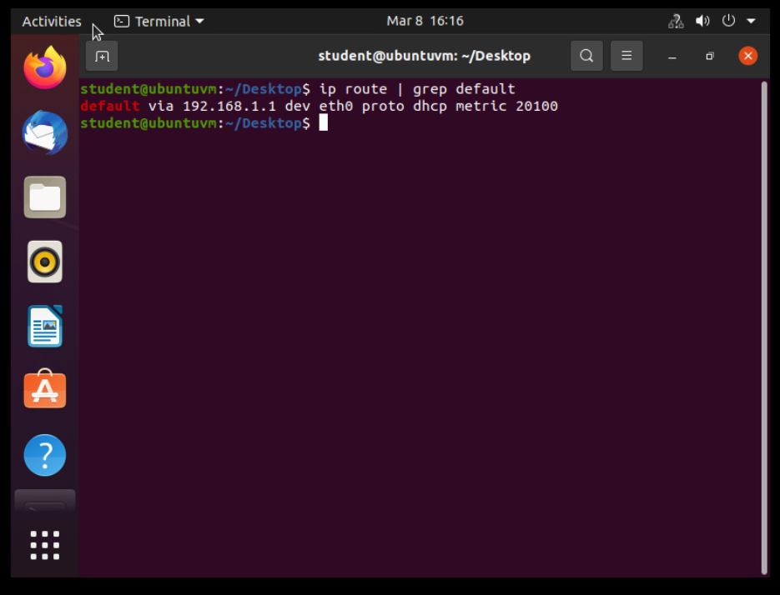
Preparation
This screenshot includes the terminal window that shows the default gateway IP address of 192.168.1.1

Slide 4
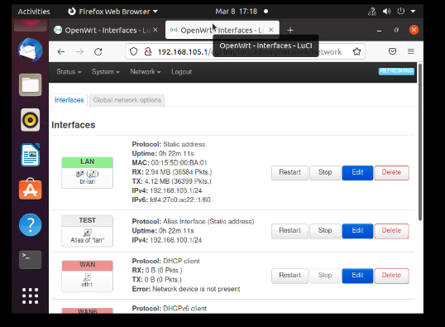
IPv4 Address Assignment
This screenshot includes the Interfaces page that shows the new IPv4 address of 192.168.105.1/24 on the LAN interface.

Slide 5

Module 3 Connectivity Test (Continuing use of VM and Linux)

Slide 6
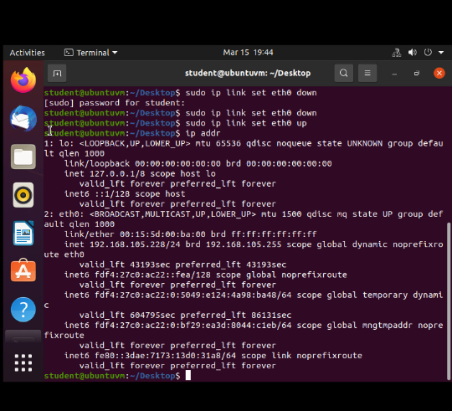
Dynamic IP Address Assignment
This screenshot shows the IPv4 address of the Computer 1 VM.
Eht0 up set the connection running, and presents the Ip address of 192.168.105.228/24.

Slide 7
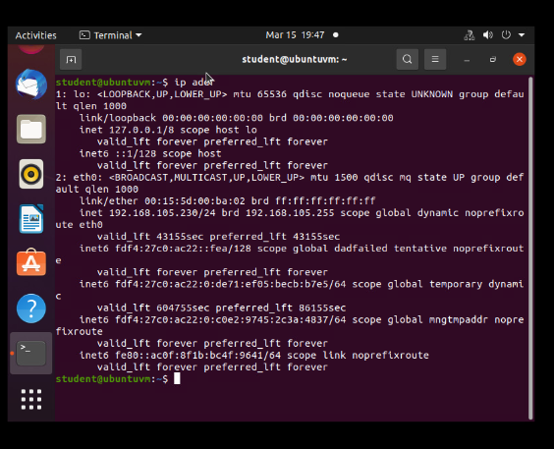
Dynamic IP Address Assignment
This screenshot should show the IPv4 address of the Computer 2 VM.

Slide 8
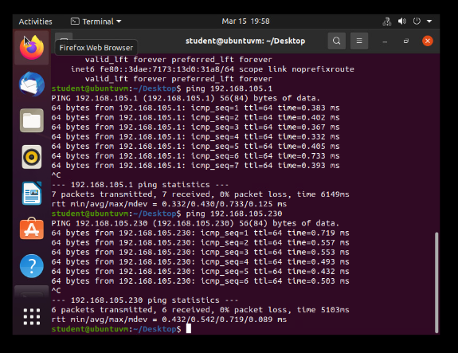
Connectivity Test(Cp 1)
This screenshot shows the use of the ping command to run connectivity tests between the Computer 1 VM and the other two devices (i.e., the SOHO Router VM and Computer 2 VM).

Slide 9
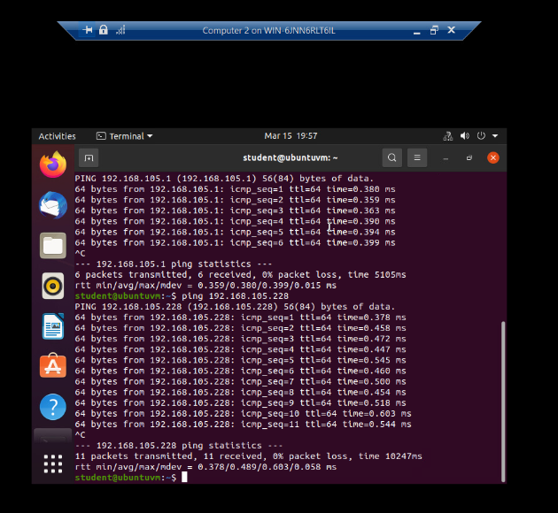
Connectivity Test(Cp2)
This screenshot shows the connectivity tests between the Computer 2 VM and the other two devices (i.e., the SOHO Router VM and Computer 1 VM).

Slide 10

Module 4 Michael Radel IP Subnetting and Loopback Interfaces

Slide 11
Subnetting Table
This table includes two /25 subnets, listing the subnet notation, network address, first usable host address, last usable host address, and broadcast address of each subnet.
 | Subnet ID | Network Mask (/prefix) | Network Mask (Dotted decimal) | Network Address | First Usable Host Address | Last Useable Host Address | Broadcast Address
The First Subnet | 0 | /25 | 255.255.255.128 | 192.168.5.0 | 192.168.5.1 | 192.168.5.126 | 192.168.5.127
The Second Subnet | 1 | /25 | 255.255.255.128 | 192.168.5.128 | 192.168.5.129 | 192.168.5.254 | 192.168.5.255

Slide 12
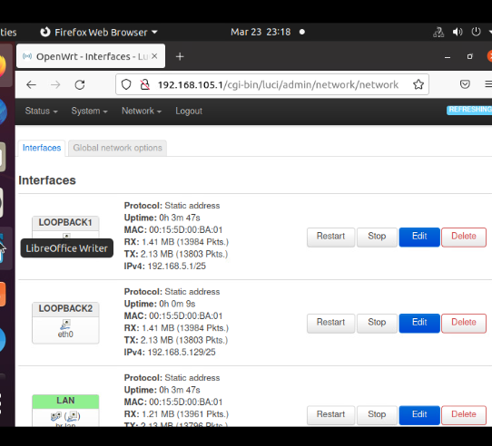
Loopback Interfaces
This screenshot shows both Loopback1 and Loopback2 interfaces and their correct IPv4 addresses.

Slide 13
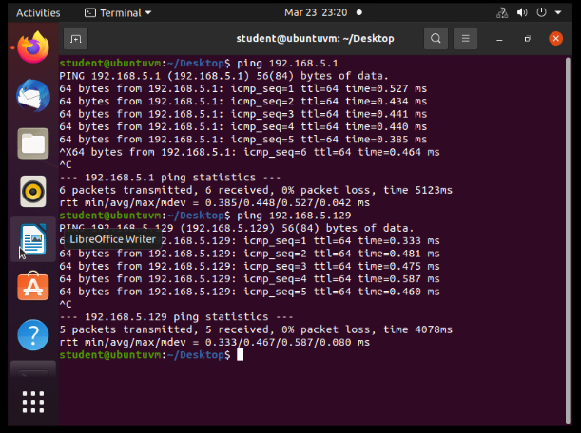
Connectivity Tests
This screenshot shows two successful ping tests from the Computer 1 VM to the Loopback 1 and Loopback 2 interfaces.

Slide 14

Module 5 Michael Radel Visio Network Diagrame

Slide 15
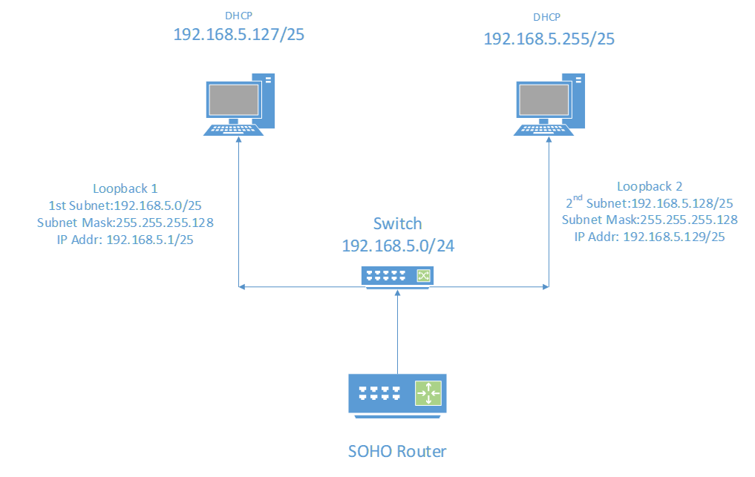
Microsoft Visio Network Diagram
This diagram illustrates the interconnection of the Computer 1 VM, the Computer 2 VM, and the SOHO Router VM along with proper addressing and labeling.

Slide 16

Module 6 Michael Radel SOHO Wireless Network Security Questions

Slide 17
SOHO Wireless Network Security
1.What are the factory default username and password of a TP-Link router? Why is it important to change the default username and password of a SOHO router?
Username: admin
Password: admin
Given the default of this setup, it is quite easy for someone with malicious intentions to gain control of your LAN and obtain access to all the addresses and network traffic.

Slide 18
SOHO Wireless Network Security
2.To protect a SOHO wireless network with a small number of devices, which address management method provides more control, configuring the device IP addresses manually (static IP) or using a DHCP server (dynamic IP)? Why?
In the case of a small LAN, utilizing a static IP address would be the more appropriate choice as it grants the network administrator greater control over connected devices, particularly in terms of identifying and detecting unauthorized addresses. On the other hand, dynamic hosts are better suited for larger networks as they can alleviate the burden on the network administrator by automatically assigning IP addresses and avoiding any potential duplication issues.

Slide 19
SOHO Wireless Network Security
3.What does MAC filtering do? If needed, when would you use deny filtering rules and when would you use allow filtering rules? What happens to devices that want to connect, if the “Allow the stations specified by any enabled entries in the list to access” function is enabled but there are no entries in the list?
MAC filtering works by creating a list of addresses that are either allowed or denied access to the network. If you use deny filtering rules, you are creating a list that are not allowed to access the network. This is useful when you want to block specific devices from accessing the network, such as those that are known to be malicious or have been identified as potential security threats or you are creating a list of addresses that are allowed to access the network. This is useful when you want to restrict access to the network to a specific set of device. If the "Allow the stations specified by any enabled entries in the list to access" function is enabled but there are no entries in the list, then no devices will be able to connect to the network, even if they are attempting to connect from a valid MAC address. You would need to add the MAC addresses of the devices that you want to allow to connect to the list before they can successfully connect to the network.

Slide 20
SOHO Wireless Network Security
4.What wireless security settings are displayed on the Wireless Security page? Which one is recommended by the vendor? Why?
WPA/ WPA2 Personal ( Recommended by vendor also include AES/TKIP encryption)
WPA/WPA2 Enterprise( Used in business location with multiple End user devices and locations)
WPE ( The most unsecure as all its weaknesses have been exploited.)
TKIP alone is also depreciated
WPA/WPA2(there is now WPA3) is recommended due to the use of encryption and set standards as it used by the government. WPA will use AES/TKIP encryption and has backwards support for WPA on older devices as we transition into WPA3.

Slide 21
SOHO Wireless Network Security
5.Among the configurations you explored in this module, which one is a true security function? Why?
WPA2/AES, I chose this because WPA2 is literally descried as a security measure. As it uses a symmetric encryption algorithm with a 128-bit key length protected passwords and networks while guarding access to anyone's LAN or WAN. While the AES makes it extremally difficult to brute force passwords.

Slide 22
SOHO Wireless Network Security
6.What would you do to protect your wireless network at home? Why?
In order to safeguard my home LAN, I have implemented a series of measures. Firstly, I modified the default IP address of my LAN to a personalized address, such as 10.0.0.1. Secondly, I employ static IP addressing to allocate specific IP ranges to each device. This approach offers the dual benefits of enabling me to track which devices are utilizing specific IP addresses, as well as detecting any unusual network activity. Furthermore, I utilize the SSID hiding feature to prevent my network name from being publicly displayed. Lastly, I have established a segregated guest network that is isolated from the host devices and cannot interact with them. To heighten the level of security, I have grouped all my IoT devices on the guest network to minimize the risk of potential security breaches.

Slide 23

Challenges
Several challenges surfaced during the project, including difficulties in memorizing information, comprehending subnetting, and understanding borrowing bits. Additionally, particular emphasis was placed on remembering key port numbers, as well as recognizing specific Class IP addresses.

Slide 24

Career Skill
Gained and required skills:
Subnetting
DNS
IP Addressing
Administration
Network Topography
Cabling
TCP/IP
Certifications to present gained skills:
CompTIA Network +
CCNA
CWNA

Slide 25

Conclusion
. I have gained knowledge of different network types, such as LANs and WANs, as well as the protocols and technologies employed to enable communication between devices, through this course. I've also learned the fundamentals of IP addressing, subnetting, and routing. My interest in pursuing further education in the field of networking has been piqued by this course, which has given me a valuable set of skills and knowledge that will be useful in a variety of fields.

